Slide 1
Big Data and The Data Warehouse
Michael Fudge

Slide 2
Organizational Decision Making
What should I do?
Why did it happen?
What Happened?
What will happen?
Automated decision making
Strategic decision making
Tactical decision making
Operational decision making

Slide 3
Data Volume
Years

Slide 4
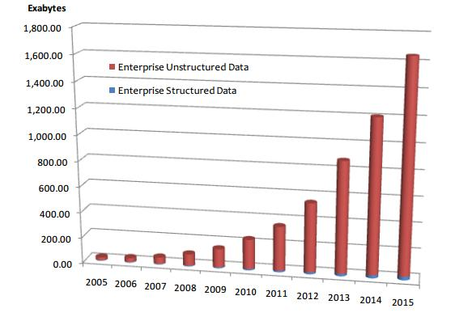
The Rise of Enterprise Unstructured Data
Most of the data required for informed decision-making is unstructured data.
* IDG

Slide 5
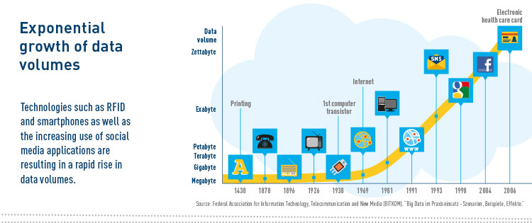
Timeline data volumes problem of big data

Slide 6



Scaling Services: How do you address growth?
Vertical “Scale Up”
Horizontal “Scale Out”
Add more resources to an existing system running the service.
Easier, but limited scale.
Single point of failure
Run the service over multiple systems, and orchestrate communication between them.
Harder, but massive scale.
Overhead to manage nodes.

Slide 7
Distributed Data
When the data volume is tool large for a single system, and you can no longer scale up…
… you scale out.

Slide 8
CAP Theorem of Distributed Systems
You can only have two of the following three guarantees:
Data Consistency: all nodes see the same data at the same time.
Data Availability: assurances that every request can be processed.
Partition Tolerance: network failures are tolerated, the continues to operate
RDBMS: MSSQL, Oracle, MySQL
Consistency
Partition
Tolerance
Availability
Single-Master: Hbase, MongoDB, Accumulo, HDFS
CA
CP
X
AP
Eventual Consistency: Dynamo, Cassandra, CouchDb

Slide 9
Why Can’t You Have All Three? *
Node 1
Node 2
A Counterexample:
Suppose we lose communication between nodes:
We must ignore any updates the nodes receive, or sacrifice Consistency or we must deny service until it becomes Available again.
If we guarantee Availability of requests, despite the failure:
We gain Partition Tolerance (the system still works), but lose Consistency (nodes will get out of sync).
If we guarantee Consistency of data, despite the failure:
We gain Partition Tolerance (again, system works) but lose Availability (data on nodes cannot be changed failure is resolved).
* You can have all three, just not at the same time.
Notes:
http://www.infoq.com/articles/cap-twelve-years-later-how-the-rules-have-changed

Slide 10
CAP: All Kinds of Database Systems.
RDBMS’s like Oracle, MySQL and SQL Server:
Focus on Consistency and Availability (ACID Principles), sacrificing Partition Tolerance (and thus they don’t’ scale well horizontally).
Use cases: Business data, when you don’t need to scale out.
Single-Master systems like MongoDb, Hbase, Redis, and HDFS:
Provide Consistency at scale but data availability runs through a single node.
Use cases: Read-heavy. Caching, document storage, product catalogs.
Eventual Consistency systems like CouchDb, Cassandra and Dynamo
Provide Availability at scale but do not guarantee consistency.
Use cases: Write heavy, Isolated activities: Shopping carts, Orders, Tweets.

Slide 11
So What is Big Data?
It’s more than just large data

Slide 12
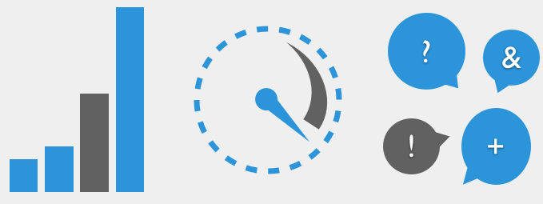
The Three V’s of Big Data
Volume
Velocity
Variety
Quantity Of Data
Rate of Change of Data
Kinds of Data

Slide 13
Other V’s of Big Data
Veracity – uncertainty of your data. How can we be confident in the trustworthiness of our data sources?
Example: Matching a tweet to a customer, without knowing their twitter.
Viability – can we predict results from the data? Can we determine which features serve as predictors?
Example: Discovering patterns among customer purchase habits and unfavorable weather conditions.
Value – what meaning can we derive from our data? Can we use it make good business decisions?
Example: Increase inventory levels of potato chips 2 weeks before the super bowl.

Slide 14
Examples Big Data Applications
Clickstream – Analyze website traffic to determine how to invenst in site improvements.
Sensor Data – Collect data from environmental sensors to identify foot traffic patterns in a retail store.
Geographic Data – Analyze on-line orders to establish consistency between where products are shipped versus ordered.
Server Logs – identify potential intrusions and mis-configured firewalls.
Sentiment – get a sense of brand through social media.
Unstructured – detect potential inside trading though email, and phone conversations.

Slide 15
Birthplace of Hadoop:
Google, Facebook, Yahoo!
These companies had so much data, that enterprise DBMSs could not meet their reporting requirements.
Time to process
1 day of data
Number of
Hours in a day.

Slide 16
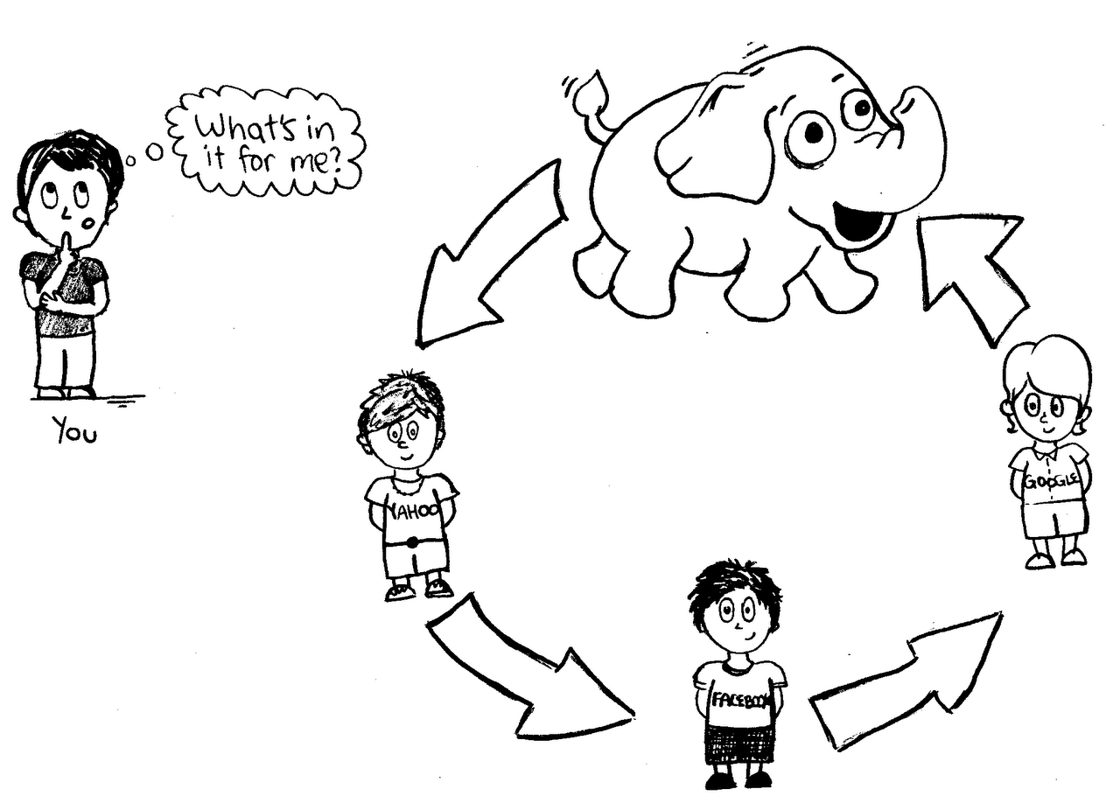
But, I’m not Google. Do I Need This?
Struggling with data volume, velocity or variety.
Insufficient resources to store, process, and analyze your data.
Notes:
Use it because you need to, not because you WANT to.

Slide 17
Common Big Data Applications
Clickstream – Analyze website traffic to determine how to invenst in site improvements.
Sensor Data – Collect data from environmental sensors to identify foot traffic patterns in a retail store. IoT.
Geographic Data – Analyze on-line orders to establish consistency between where products are shipped versus ordered.
Server Logs – identify potential intrusions and mis-configured firewalls.
Sentiment – get a sense of brand through social media.
Unstructured/Text – detect potential inside trading though email, and phone conversations.

Slide 18
What is Hadoop?

Slide 19
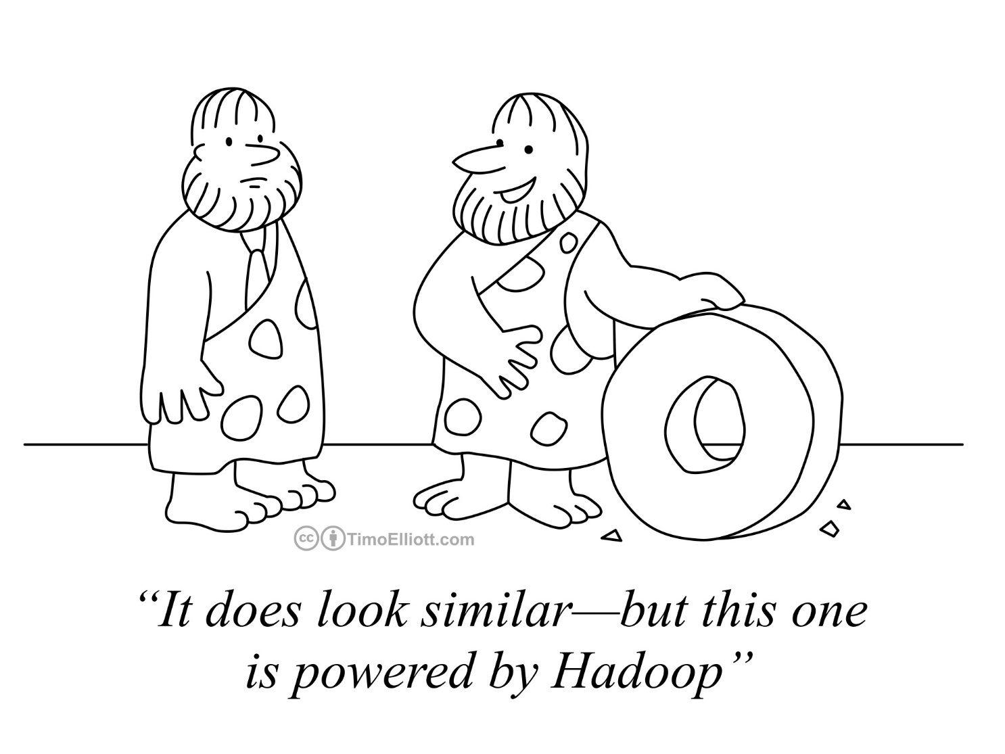
What Is Hadoop?
A System For:
Storing,
Processing, and
Managing
Data.
Sounds Familiar?
Yes. Change “Data” To “Big Data”

Slide 20
Hadoop Handles Big Data By Scaling Out
Problem: File Too Large to fit on a single storage platform?
Solution: Distribute the file over several computers.
Problem: Server not “fast” enough to process your data.
Solution: Distribute data processing over several computers.
Data
Processing

Slide 21

Hadoop is Designed to Use Commodity Hardware
Hadoop Hardware
Modular
Easy to add and remove nodes.
Failure is not only acceptable, but expected.
This is contrary to enterprise hardware
High-redundancy / Fault-tolerant
Vertical Scaling
Storage arrays
* Google Hardware spec for server source: C|NET

Slide 22
An Example of the “Hadoop Way of Doing Things”
* Photo of the Hadoop cluster at Yahoo!

Slide 23
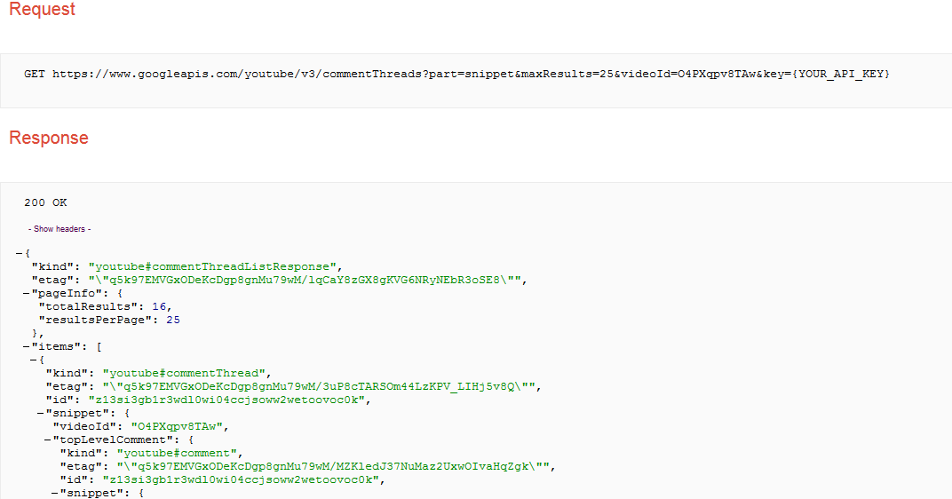
Collect and Store Data As-Is, Schema-less.
YouTube Comments
Notes:
Common use case of Hadoop is collect output from another system, and store it as is because you don’t know how you want to analyze it yet.
You don’t know what parts of the JSON output you will need. This data is schema-less which means we don’t have to apply any logic at write-time as we would normally with a relational database management system.

Slide 24
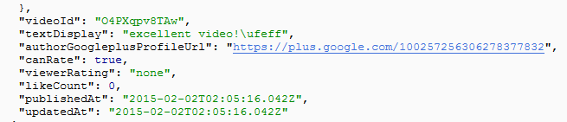

Apply a Schema on Read
videoId | likes | text | pub_date
O4PXqpv8TAw | 0 | excellent video!\ufeff | 2015-02-02T02:05:16.042Z
… | … | … | …
Notes:
When we want to perform analysis on our data, we apply a schema as it is read to that it can be placed in a tabular form for analysis.
You don’t have to define a full schema to all the data – only the data you care about.
Once the schema is applied we can further process the data in tabular format.

Slide 25

Analyze Your Data
videoId | likes | text | pub_date
O4PXqpv8TAw | 0 | excellent video!\ufeff | 2015-02-02T02:05:16.042Z
… | … | … | …
Export / Visualize
videoId | sum(likes)
O4PXqpv8TAw | 56
V56Xqyy-2wq | 14
… | …
Notes:
When your data is in tabular format you can process it further and then visualize it.
Hadoop has tools to visualize your data, you can also export the data, provided it has been reduced to a reasonable side.
The entire process can be automated so that as new data is collected it can be processed and visualized.

Slide 26
How Does Hadoop Store, Process and Manage Big Data?

Slide 27
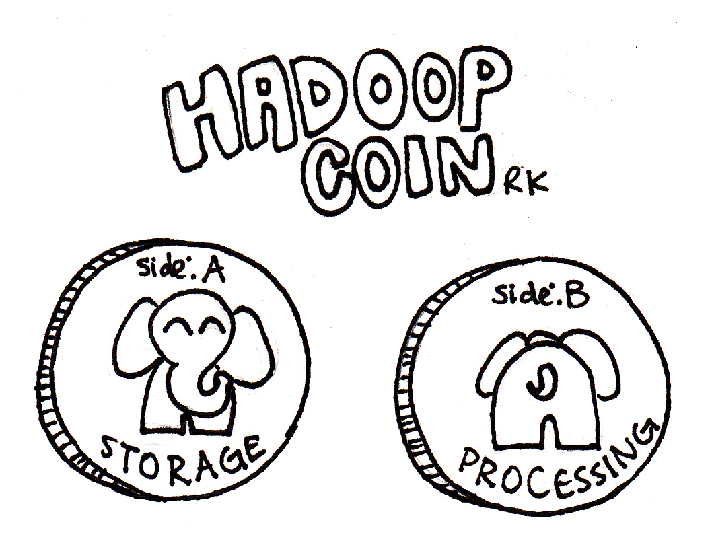
Two Goals of Hadoop
Distribute the data. HDFS Does this
Move processing to the data. MapReduce / YARN Does this

Slide 28
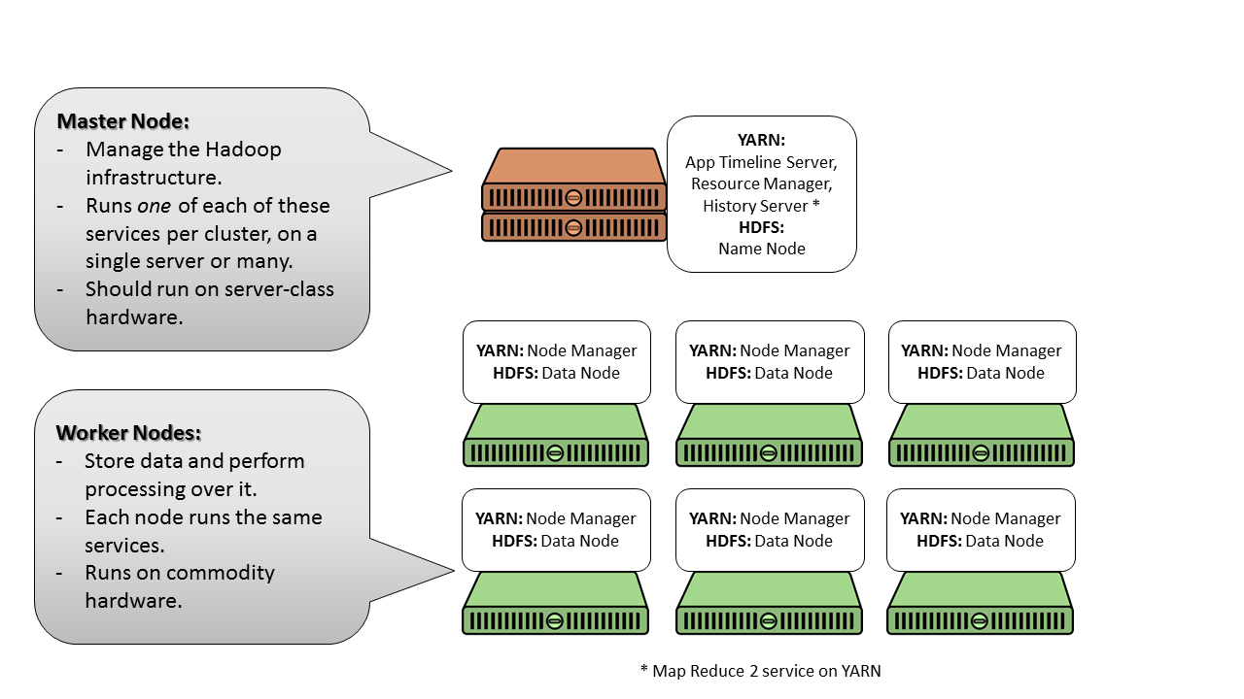
Hadoop Clusters
3 Node Types:
Master Nodes
Worker Nodes
Client Nodes

Slide 29
How Does Hadoop Differ from Relational?
Relational
Hadoop
Schema On Write
Fast Reads
Highly Structured Data
Declarative Data Processing (SQL)
Good For: ACID Transactions, Business Data
Schema On Read
Fast Writes
Loosely Structured Data
Declarative & Procedural Data Processing
Good For: Logs, Data Streams, Unstructured, Data Discovery

Slide 30
What Exactly is “Schema on Read?” Again?
Traditional RDBMS
You cannot write data without a table.
Cannot insert data unless data fits into table’s single design.
Large up front design costs.
Conceptual Models
Table Design
“Schema on Write”
Hadoop’s HDFS
You write the data “as-is”, to HDFS.
Schema applied when data is read – multiple designs.
Very little up-front design costs
Just Write to disk
Apply schema when you need it
“Schema on Read”

Slide 31















The Hadoop Ecosystem: Open Source Tools
Hadoop
HDFS
Notes:
Feel free to spend a lot of time on this slide. Many of these frameworks are not discussed later in the course, so now is likely your only chance to explain them. Let the students ask questions and make the discussion interactive.

Slide 32


An Over-Simplified Version of the Hadoop Ecosystem in Action
Relational Business Data
Sqoop: Ingest relational data
HDFS Data Lake Data stored “as is”
Pig, Spark: Explore data,
Transform data, Add structure
Flume: Ingest logs and data streams
Unstructured Data (Logs, Social, text, etc.)
Hive, Spark-SQL: Ad-Hoc Query Structured data for Descriptive and Diagnostic Analytics
Mahout, Spark MLlib, R: Mine Structured Data for Predictive and Prescriptive Analytics

Slide 33
HDFS: Hadoop Distributed File System
Based on Google’s GFS
Data Distributed over Physical Nodes
Designed for Failover
Data Stored “as is”
Data Split into Blocks
Default Replication factor is 3

Slide 34
HDFS At Work
Client:
1) Issues command to write data.csv file to HDFS
File: data.csv
$ hadoop fs –put data.csv
Namenode:
2) Splits the file into 64MB blocks (size can be changed).
3) Writes each block to a separate Datanode.
4) Replicates each block a number of times (default is 3).
5) Keeps track of which nodes contain each block in the file.
Namenode /users/mafudge/data.csv
1
2
3
4
1
3
2
4
3
2
1
2
3
4
Datanodes
4
3
1
4
2
1

Slide 35
How do you get data into HDFS?
HDFS Command Line: $ Hadoop fs –put file
WebHDFS – REST API for HDFS commands
Sqoop- Import / Export with other DBMS’s
Flume – Import logs, events, social media
Storm – real-time event proceessing
MapReduce Job output

Slide 36
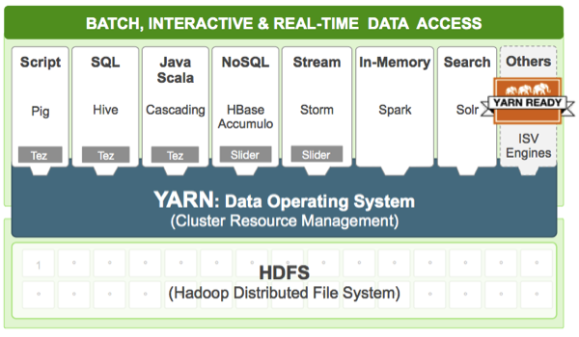
YARN: The Data Operating System
Hadoop 2.0 Introduces YARN (Yet Another Resource Negotiator)
Orchestrates processing over the nodes.
Uses HDFS for storage.
Runs a variety of Applications.

Slide 37
MapReduce
A Programming Model for large scale distributed data processing.
Foundations in functional programming, LISP.
Map → Apply a transformation to a data set.
Shuffle → Transfer output from mapper to reducer nodes
Reduce → Aggregate items into a single result.
Combine → Output of reducer nodes into single output.
In Hadoop 2.0, MapReduce programs use HDFS and YARN.
Map
Shuffle
Reduce
Combine

Slide 38
MapReduce Example: Orders for each Month
Source
File
HDFS Blocks Namenodes
Mapping
Shuffle
Reduce
Result
JAN, NY, 3
JAN, PA, 1
JAN, NJ, 2
JAN, CT, 4
FEB, PA, 1
FEB, NJ, 1
FEB, NY, 2
FEB, VT, 1
MAR, NJ, 2
MAR, NY, 1
MAR, VT, 2
MAR, PA, 3
JAN, NY, 3
JAN, PA, 1
JAN, NJ, 2
JAN, 3
JAN, 1
JAN, 2
JAN, 3
JAN, 1
JAN, 2
JAN, 4
JAN, 10
JAN, CT, 4
FEB, PA, 1
FEB, NJ, 1
JAN, 4
FEB, 1
FEB, 1
FEB, 1
FEB, 1
FEB, 2
FEB, 1
JAN, 10
FEB, 5
MAR, 8
FEB, 5
FEB, NY, 2
FEB, VT, 1
MAR, NJ, 2
FEB, 2
FEB, 1
MAR, 2
MAR, NY, 1
MAR, VT, 2
MAR, PA, 3
MAR, 1
MAR, 2
MAR, 3
MAR, 2
MAR, 1
MAR, 2
MAR, 3
MAR, 8

Slide 39
MapReduce: Total Orders by State
Source
File
HDFS Blocks Namenodes
Mapping
Shuffle
Reduce
Result
JAN, NY, 3
JAN, PA, 1
JAN, NJ, 2
JAN, CT, 4
FEB, PA, 1
FEB, NJ, 1
FEB, NY, 2
FEB, VT, 1
MAR, NJ, 2
MAR, NY, 1
MAR, VT, 2
MAR, PA, 3
JAN, NY, 3
JAN, PA, 1
JAN, NJ, 2
NY, 3
PA, 1
NJ, 2
CT, 4
CT, 4
NJ, 2 NJ, 1 NJ, 2
NJ, 5
CT, 4 NJ, 5
NY, 6
PA, 5
VT, 3
JAN, CT, 4
FEB, PA, 1
FEB, NJ, 1
CT, 4
PA, 1
NJ, 1
NY, 3
NY, 2
NY, 1
NY, 6
FEB, NY, 2
FEB, VT, 1
MAR, NJ, 2
NY, 2
VT, 1
NJ, 2
PA, 1 PA, 1 PA, 3
PA, 5
MAR, NY, 1
MAR, VT, 2
MAR, PA, 3
NY, 1
VT, 2
PA, 3
VT, 1 VT, 2
VT, 3

Slide 40
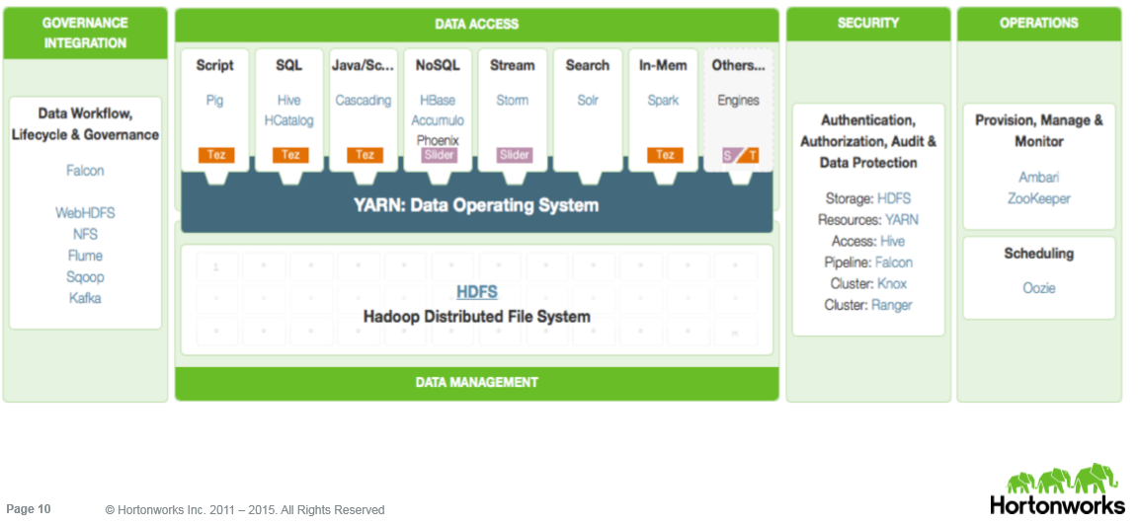
Today’s Hadoop
… A Suite of Open-Source, Distributed Technologies

Slide 41
Hadoop Tools
MapReduce is great but there’s a need for high-level scripting.
There are also other needs beyond batch capabilities of M-R.

Slide 42

Pig
Platform for analyzing large data sets, performing ETL, Data cleanup, etc.
Write code simpler MapReduce in “piglatin” instead of Java.
Steps:
LOAD
TRANSFORM
STORE /DUMP

Slide 43

Hive
SQL-Like Syntax over HDFS.
Declarative, not Procedural like Pig.
Useful for Ad-hoc query of HDFS data.

Slide 44

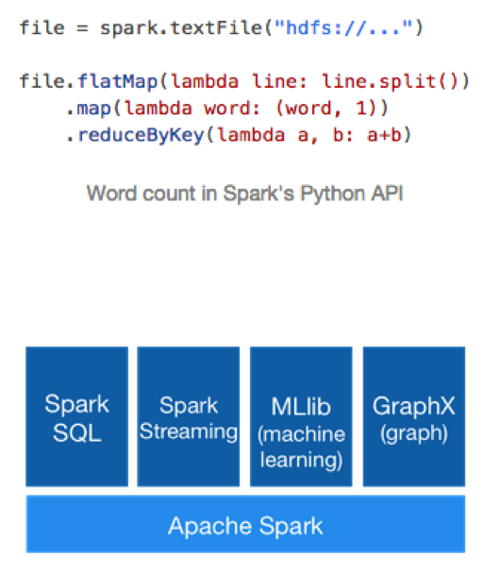
Spark
Spark is a cluster computing framework
Extends the M-R metaphor in memory for large-scale data processing.

Slide 45
Big Data == Data Warehouse Data
Subject Oriented → web logs, messages, transactions
Time-Variant → data reflects the point in time
Integrated → data comes from a variety of sources
Non-Volitle → data written does not change

Slide 46
Big Data and The Data Warehouse
Michael Fudge

